Slide 1

FAKE JOB PREDICTION
By Mevina P.D

Slide 2
Introduction
Fake job postings are increasing on online platforms, causing financial and emotional loss to job seekers. Identifying genuine jobs has become difficult due to this growing fraud.
This project, “Fake Job Detection Using Machine Learning,” uses data analysis and machine learning techniques to classify job postings as fake or real. It also includes an Excel dashboard to visualize trends and improve awareness.

Slide 3
Problem Statement
Many job seekers are falling victim to fake job postings online. It is difficult to identify fake jobs manually. There is a need for an automated system to detect fake job postings and protect users from fraud.

Slide 4
Objectives
To analyze job posting data and identify fake jobs.
To develop a machine learning model for fake job detection.
To classify job postings as real or fake accurately.
To create an interactive dashboard for data visualization.
To help job seekers avoid online job fraud.

Slide 5
DATA PREPROCESSING
Removed missing and duplicate values.
Cleaned and formatted text data.
Converted categorical data into numerical format.
Applied feature selection techniques.
Split data into training and testing sets.

Slide 6
EDA(Exploratory Data Analysis) Visual
Used pie charts to show Fake vs Real job distribution.
Created bar charts for jobs by location and company.
Used column charts for department-wise job postings.
Analyzed trends using line charts.
Visualized key insights using Excel dashboard.

Slide 7
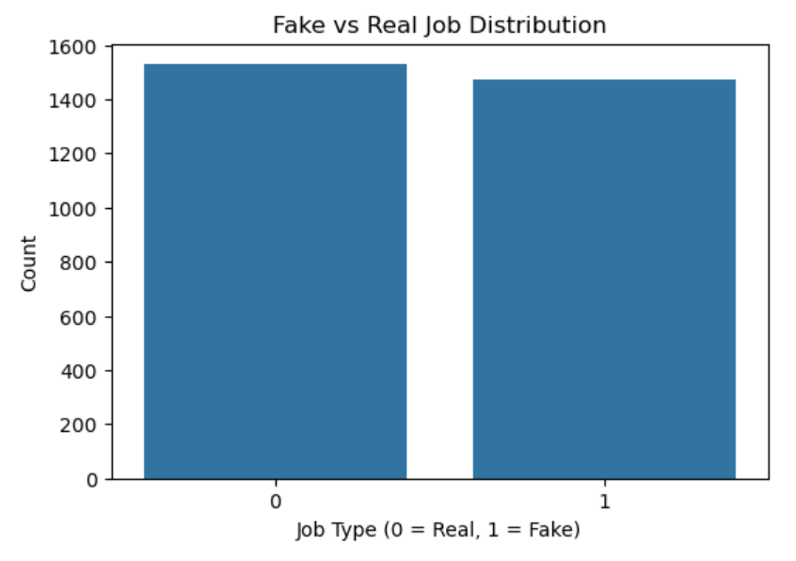

Slide 8
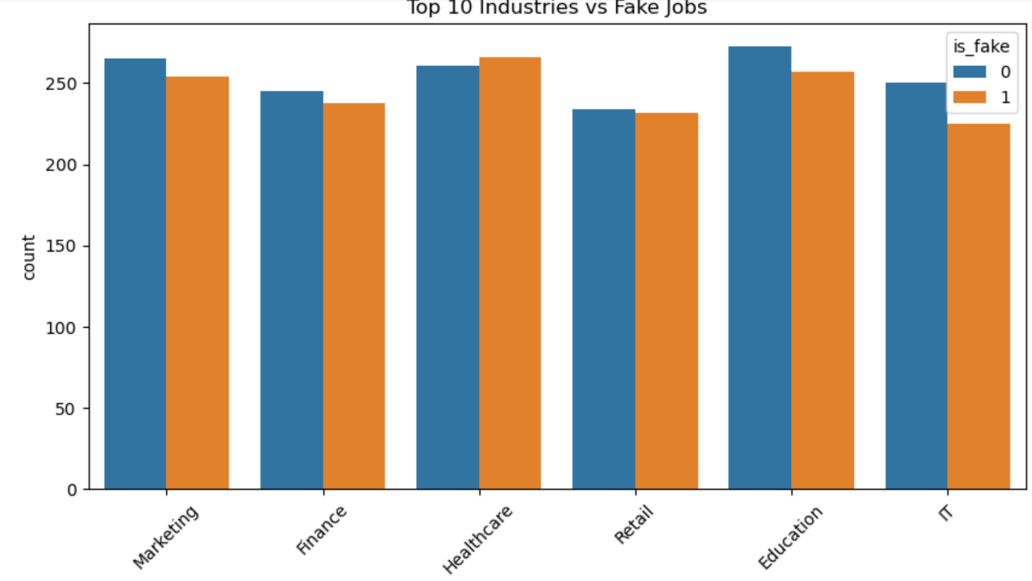

Slide 9
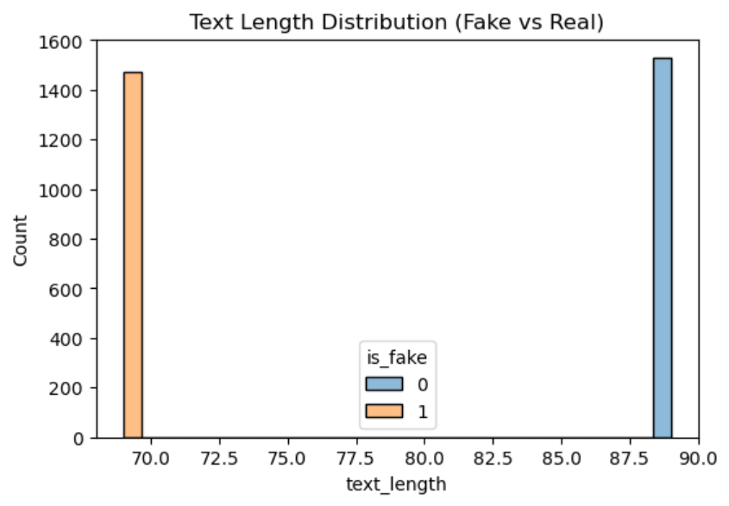

Slide 10
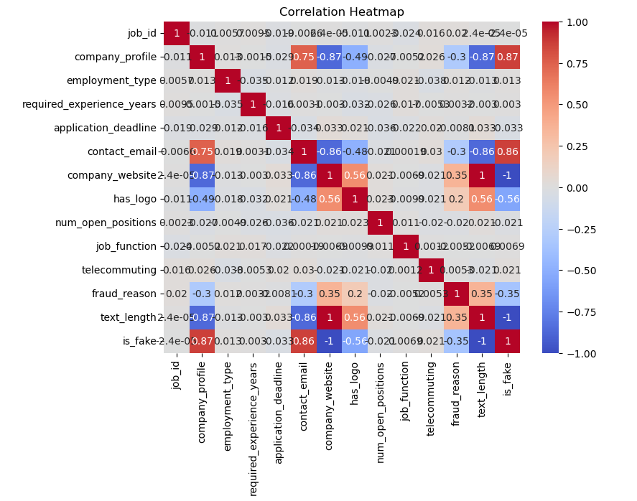

Slide 11
Machine Learning Models
Model Name | Accuracy Score | Performance
Logistic Regression | 89% | Good
Decision Tree Classifier | 85% | Average
SVC | 90% | Very Good
Random forest classifier | 93% | Best

Slide 12
Best Model –Random Forest Classifier
Ensemble-based approach
More reliable predictions
Less overfitting
Selected for final deployment
Highest accuracy: 100%

Slide 13
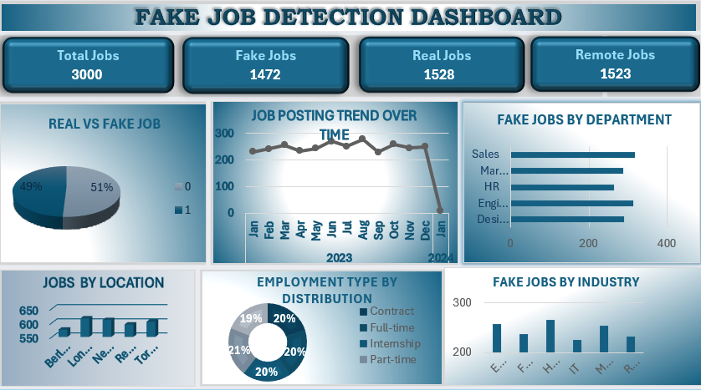
Dashboard Overview

Slide 14
Conclusion
Developed a machine learning model to detect fake job postings.
Performed data preprocessing and feature extraction using TF-IDF.
Applied multiple classification algorithms for prediction.
Random Forest was selected as the best performing model.
This system helps job seekers avoid fraudulent job postings.

Slide 15
Future Scope
Helps job seekers identify fake job postings easily.
Reduces online job fraud and scams.
Saves time and money of applicants.
Increases trust in online recruitment platforms.
Supports safer job searching environment.
Helps companies protect their reputation.
Can be used by students and freshers for safe job search.

Slide 16
Thank You

